Slide 1

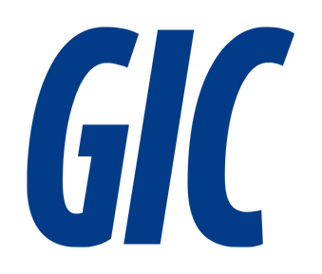
شركة الخليج المتكاملة للمقاولات
Done by :
Sultan Khalid Aseeri 20161851
Abdulla Theeb Aldoseri 20191736
Halima Khalid Aldoseri 202202954
Zainab Isa Alzayani 202203207

Slide 2

Introduction
Gulf Integrated Contractors (GIC) was established to overcome the operational challenges faced by Gulf Consolidated Contractors (GCC), such as high costs, manual reporting, and communication delays—despite using SAP ERP. To modernize operations, GIC implemented Odoo ERP, a flexible and open-source platform. This case study outlines how Odoo replaced outdated systems, streamlined processes, and improved overall efficiency, showing its effectiveness in addressing real challenges in the construction industry.

Slide 3
Problem Statement
High operating costs despite using SAP ERP
Lack of flexibility in adapting to project-specific needs
Heavy dependence on manual data entry and reporting
Difficulty in tracking project progress in real-time
Delays in internal communication and coordination
Inefficient HR and resource management processes

Slide 4
Objectives
Streamline overall company operations
Automate routine tasks through selected Odoo ERP modules
Improve project tracking for better visibility and control

Slide 5


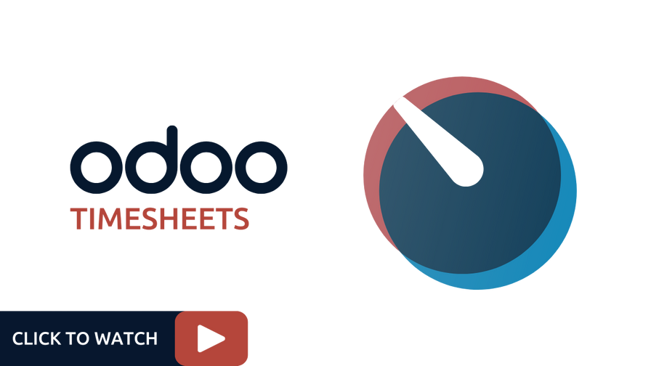

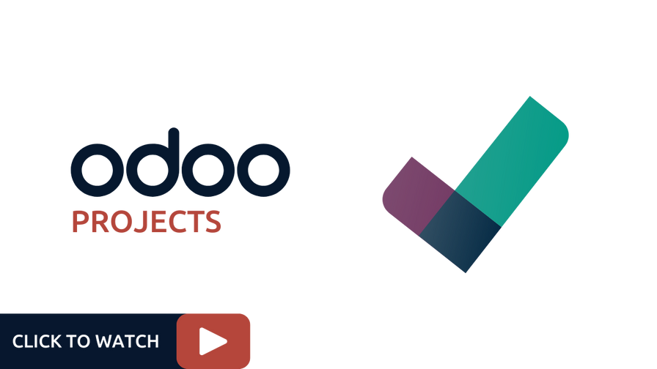



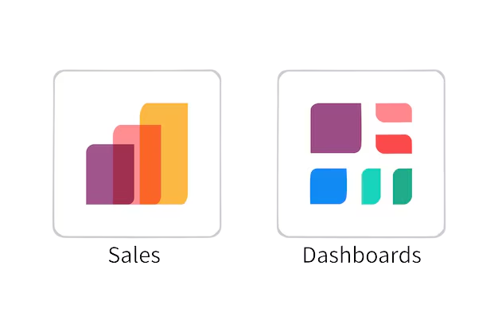

Odoo Modules Used

Slide 6
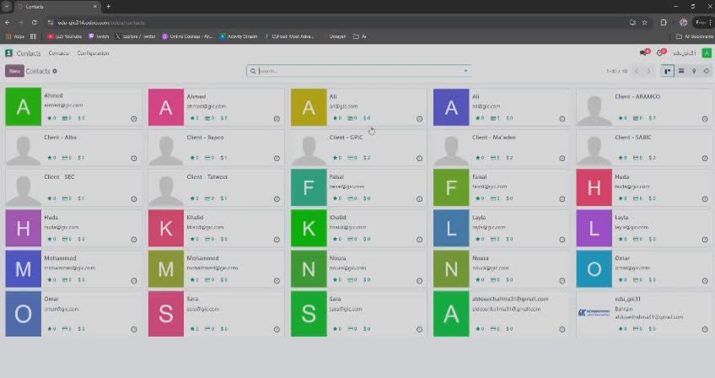
System Demo

Slide 7
Challenges & Solutions
GCC Challenge | GIC Improvement via Odoo
Excel reliance for reporting | Real-time dashboards and integrated reports
Delayed interdepartmental communication | Seamless module integration
Manual project tracking | Digital project and timesheet modules
Complex and expensive ERP | User-friendly, low-cost Odoo setup
Manual equipment logs | Automated maintenance tracking

Slide 8
Results
Improvements made by using odoo
Reduced manual work
User engagement
Improved integration
Cost efficiency
Operational visibility

Slide 9
Conclusion
Implementing Odoo ERP enabled GIC to overcome key operational challenges inherited from GCC.
The new system streamlined processes, reduced manual workloads, and enhanced communication across departments.
Odoo’s flexibility and modularity proved effective for addressing real-world construction industry needs.

